Slide 1
Music Genre Classification Using Convolutional Neural Networks
Deep Learning
DS 6050
Léa Runesha
lgr2sge
Notes:
Hey, my name is Léa Runesha and today, I’m excited to walk you through my project, which focuses on building a deep learning model for automatic music genre classification. This model leverages convolutional neural networks (CNNs) in combination with Mel-spectrograms to recognize genre characteristics in audio tracks. We'll cover why this matters, how the model was built and trained, and where it could go from here.

Slide 2




Motivation
Challenge
Why It Matters
Manual genre classification is time-consuming, inconsistent, and difficult to scale.
Streaming services like spotify and apple music use genre tags to power discovery and personalization.
Music archives and content libraries need reliable metadata for organization.
Automating this process allows for broader scalability and more consistent labeling.
Notes:
Music genre tags shape the way we explore and discover music, especially on streaming platforms. But assigning these tags manually can be slow and subjective. Using deep learning, we can automatically and consistently identify genres—even in massive, uncurated audio collections. This has implications not just for commercial platforms but also for independent creators and archivists.

Slide 3
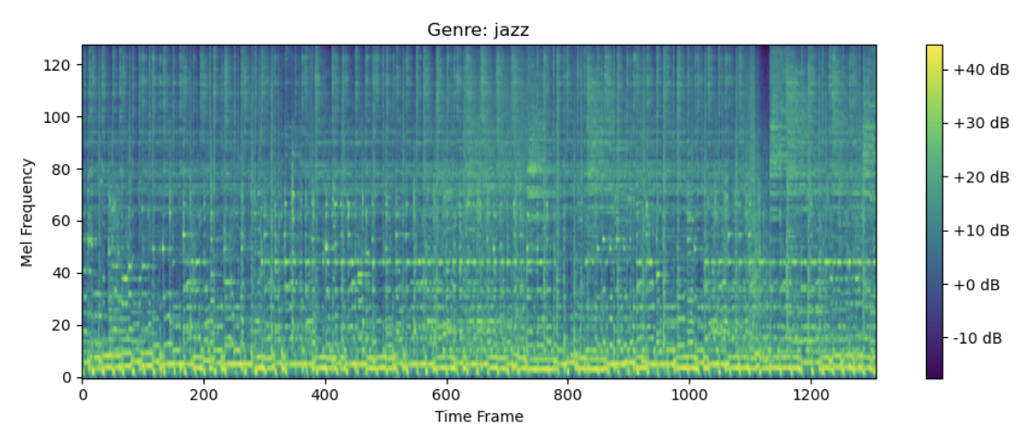
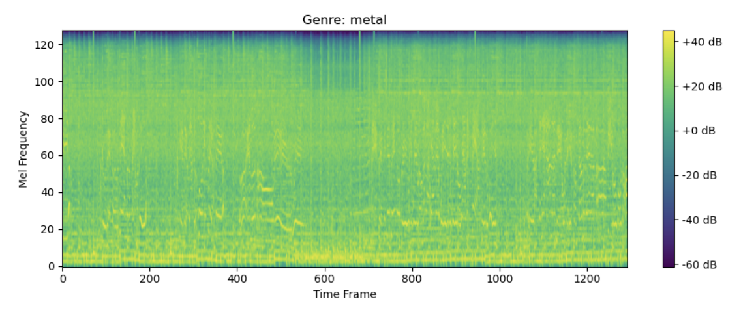
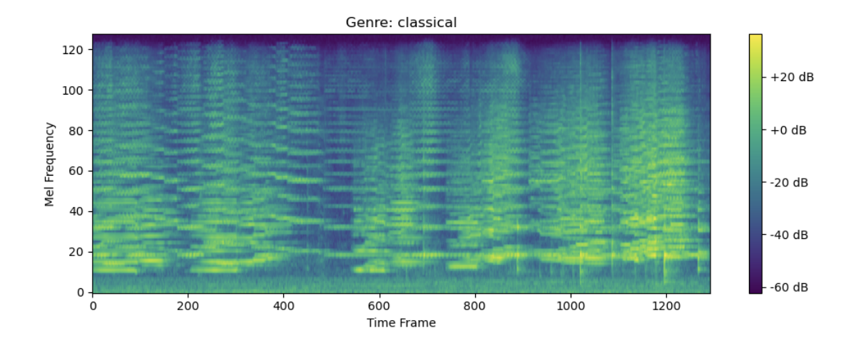
Cleaning & Preprocessing the Dataset
GTZAN Music Genre Collection
1,000 tracks across 10 distinct genres (e.g., rock, jazz, hip-hop, classical); each track is 30 seconds long
Preprocessing Steps:
Downsampled to 22.05kHz and converted to mono
Converted into Mel-spectrograms to capture frequency-time dynamics
Normalized via decibel scaling
Challenges: Some files were corrupted and had to be skipped (e.g. jazz.00054.wav)
Notes:
my project uses the GTZAN dataset from kaggle, which is used in music information retrieval research. After cleaning and preprocessing, each audio file was transformed into a Mel-spectrogram—a time-frequency representation that the CNN can analyze. Here are a couple of examples, This approach allows the model to pick up on sonic patterns like rhythm and texture, which are often genre-specific.

Slide 4
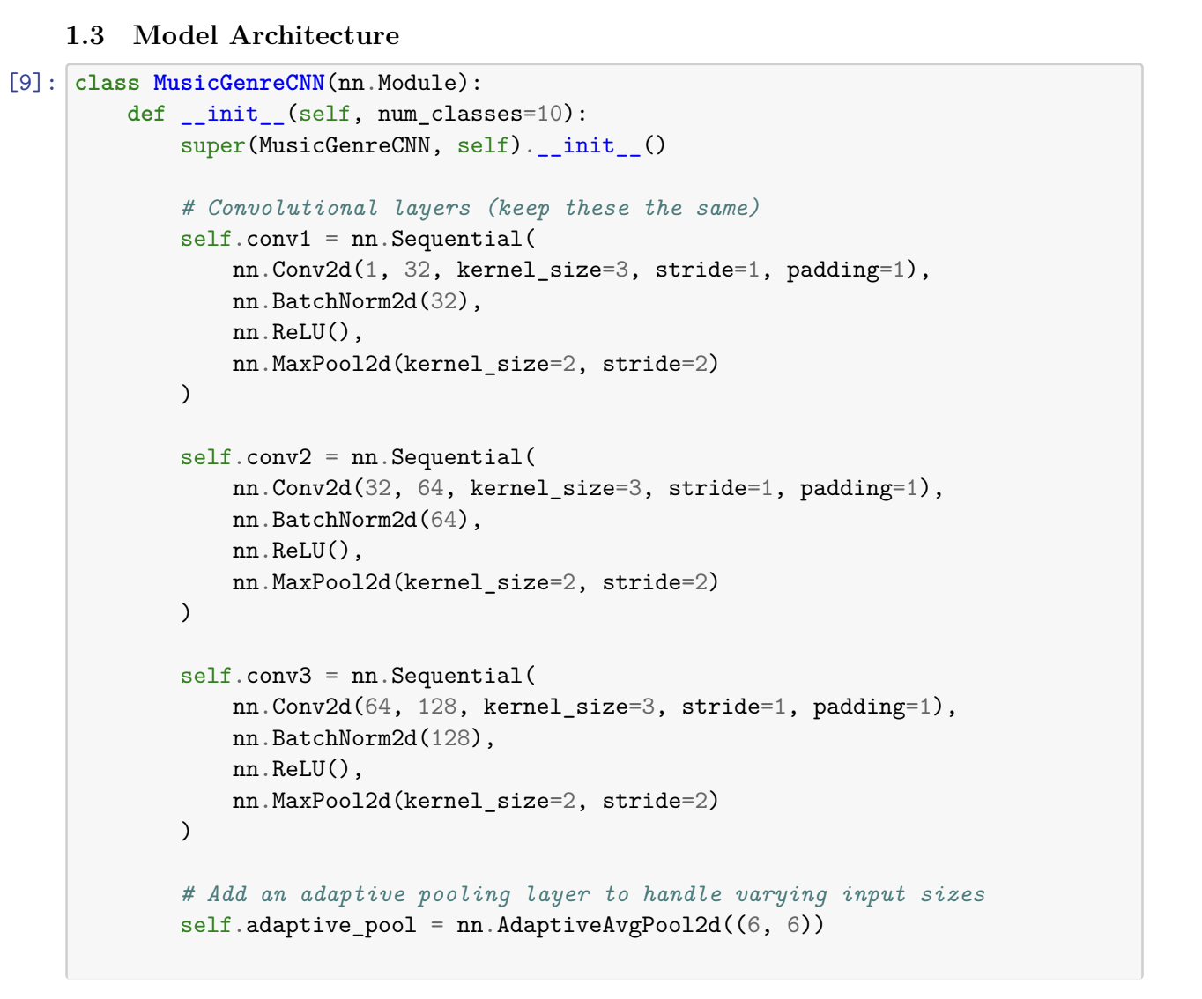
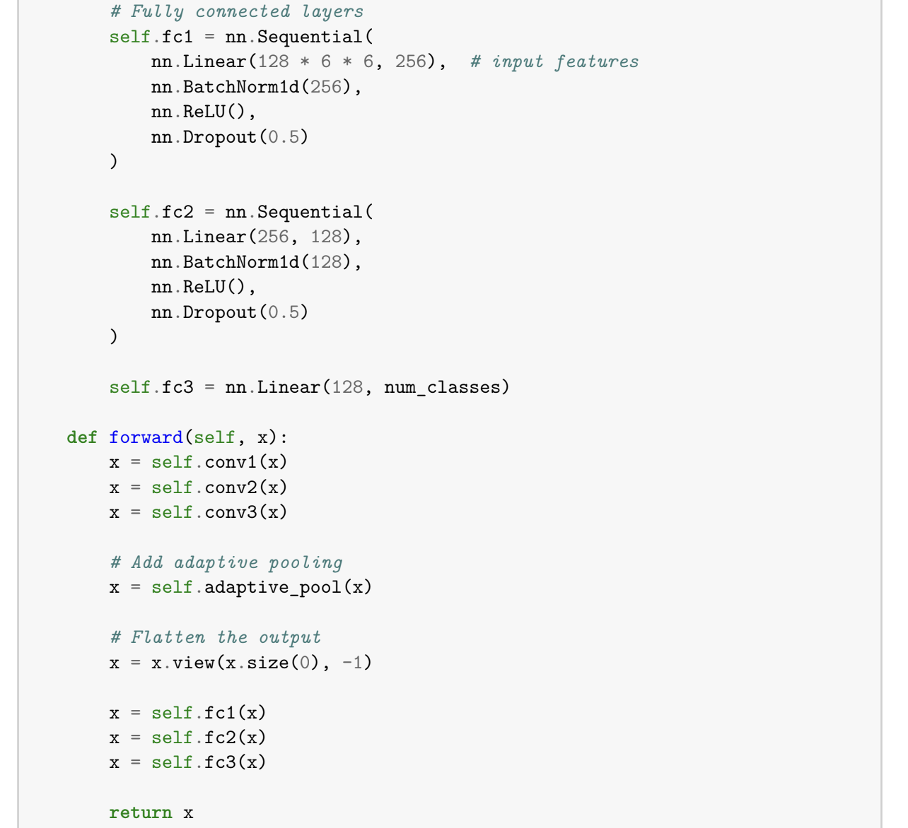
Model Architecture
CNN Structure:
3 convolutional layers with increasing filter depth (32 → 64 → 128)
Batch normalization and ReLU activation after each convolution
MaxPooling layers reduce dimensionality
Adaptive average pooling ensures uniform output size
Fully connected layers with dropout (0.5) to mitigate overfitting
Notes:
The CNN is structured to first extract low-level features like short-term rhythms and textures, and then learn higher-level abstractions relevant to genre. Adaptive pooling is key here because it ensures that we can handle spectrograms of varying lengths. Then, we can flatten the output and pass it through two fully connected layers with dropout, helping the model generalize and avoid overfitting.

Slide 5
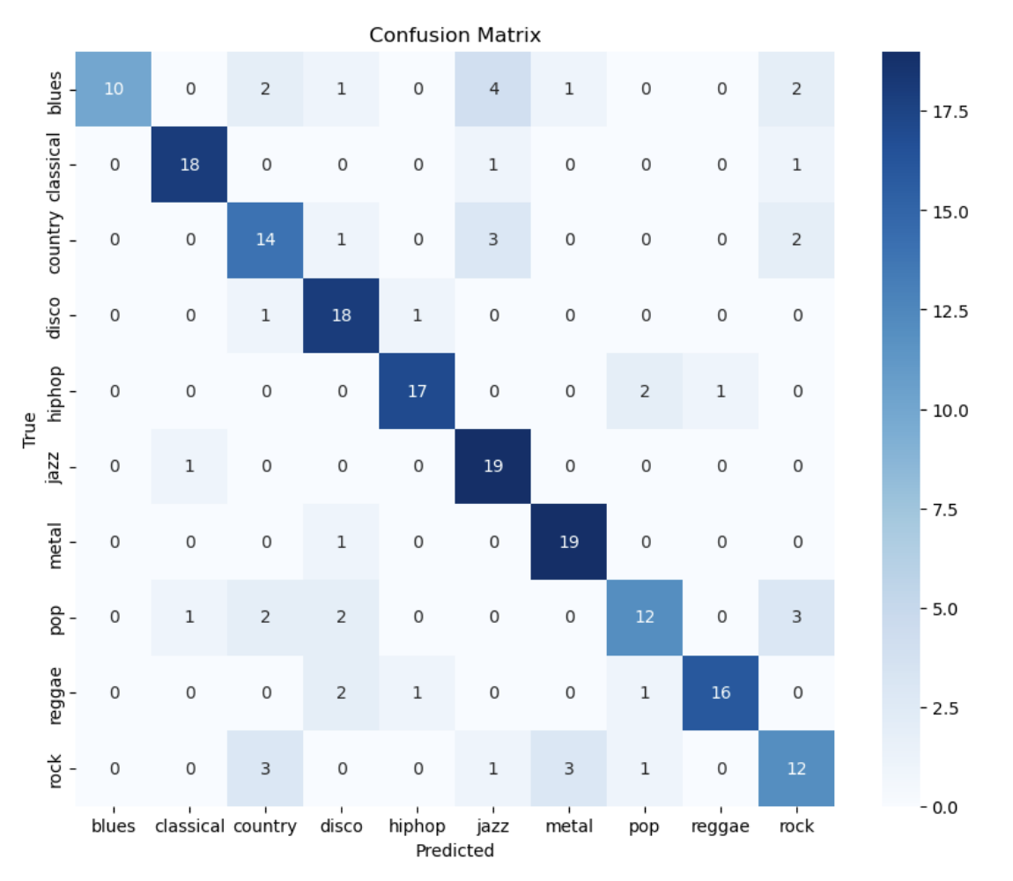
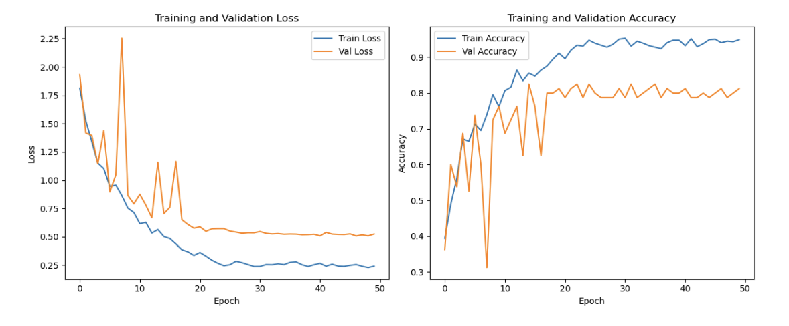
Training & Evaluation Training Details
Optimizer: Adam with ReduceLROnPlateau for dynamic learning rate adjustment
Loss Function: CrossEntropyLoss
Batch size: 32 | Epochs: 50
Performance Metrics:
Overall Test Accuracy: 77.5%
Best Performance: Classical (90%), Metal (88%)
Weakest: Rock (60%), Blues (67%)
Notes:
The model steadily improved over 50 training epochs, with training accuracy peaking above 94%. The final test accuracy was 77.5%, which is fairly good for a baseline model. Notably, genres like classical and metal had distinct features that the model learned well. However, blues and rock—genres that share sonic elements—were often confused, as shown in the confusion matrix.

Slide 6
Conclusion
Broader Implications:
Limitations:
Potential Future Work:
This project:
Built a CNN that classifies music genres using visual features from Mel-spectrograms
Achieved 77.5% accuracy with minimal tuning
Highlights both the strengths and limitations of CNNs in audio classification
This work can now go on to support independent artists, librarians, and even small apps looking for automatic genre tagging.
No use of temporal modeling (e.g., LSTM or attention mechanisms)
No audio data augmentation was applied
Dataset size is relatively small and lacks diversity
Add RNN or Transformer layers for temporal sequencing
Introduce data augmentation techniques like pitch shifting or time stretching
Use larger, more diverse datasets like the Million Song Dataset
extending this model or apply it to new datasets
Notes:
While the CNN worked well, it doesn’t capture long-term temporal dependencies—important for understanding rhythm and musical phrasing. Future versions could incorporate LSTMs or attention mechanisms to address this. Additionally, data augmentation and more diverse datasets would help the model generalize to real-world music beyond the ten genres in GTZAN.
This project shows that CNNs can offer a solid foundation for automatic genre classification. With more advanced modeling and data strategies, this work could potentially scale into tools used in music discovery platforms or content curation apps. If you're interested in music information retrieval, I encourage you to experiment with augmentations, hybrid architectures, and new datasets. Thank you.

Slide 7
References
Tzanetakis, George, and Perry Cook. GTZAN Genre Collection. Audio dataset. University of Victoria, 2002. Accessed via Kaggle. https://www.kaggle.com/datasets/androidadvance/qtzan-dataset-music-genre-classification.
Dieleman, Sander, and Benjamin Schrauwen. "End-to-End Learning for Music Audio." Preprint, submitted June 9, 2015. arXiv:1506.03194.
Pons, Jordi, Xavier Serra, and Joan Serrà. "End-to-End Learning for Music Audio Tagging at Scale." IEEE/ACM Transactions on Audio, Speech, and Language Processing 26, no. 8 (August 2018): 1680–1693. https://doi.org/10.1109/TASLP.2018.2836343.
Paszke, Adam, Sam Gross, Francisco Massa, et al. "PyTorch: An Imperative Style, High-Performance Deep Learning Library." Advances in Neural Information Processing Systems 32 (2019): 8026–8037.
TorchAudio Contributors. TorchAudio: Audio Data Loading and Augmentation for PyTorch. Computer software, 2022. https://pytorch.org/audio/stable/index.html.
Pedregosa, Fabian, Gaël Varoquaux, Alexandre Gramfort, et al. "Scikit-learn: Machine Learning in Python." Journal of Machine Learning Research 12 (2011): 2825–2830.
Librosa Development Team. Librosa: Audio and Music Processing in Python. Computer software, 2023. https://librosa.org/.
Choi, Keunwoo, George Fazekas, and Mark Sandler. "Automatic Tagging Using Deep Convolutional Neural Networks." Preprint, submitted June 1, 2016. arXiv:1606.00298.
Thickstun, John, Zaid Harchaoui, and Sham Kakade. "Learning Features of Music from Scratch." International Conference on Learning Representations (2017). https://openreview.net/forum?id=ryFm1j-C-.

Slide 8
Questions?

